Slide 1
Crystallisation

Slide 2
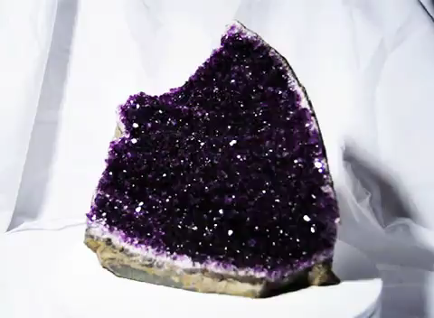
By the end of this Smart Lesson, you should be able to:
Describe how crystallisation differs from evaporation.
Explain what a saturated solution is and how temperature affects concentration.
Outline the method of crystallisation.

Slide 3
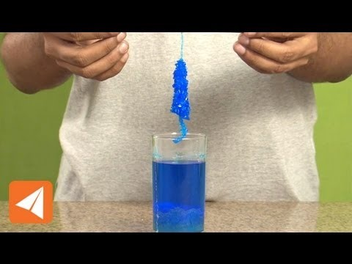

Slide 4
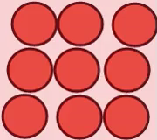
As a solution heats up, it becomes more soluble.
A hot liquid has more space inside it than a cold one. This is because all of the particles move around more because of the extra energy.
If there is more space available in a liquid, then more solute can fit into it!

Slide 5
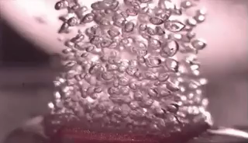
Hot liquids can fit more solute in than cold ones.
The saturation point is raised when solutions are warmer.
Overall, this means that more solute can be dissolved into hot solutions. This makes them more concentrated.

Slide 6
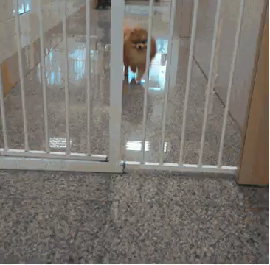
We can take a saturated solution, heat it, and then dissolve more solute until the solution is saturated again.
What happens when the solution cools down?
Well, the solute will leave the solution as the saturation point lowers!

Slide 7

When a particle leaves a solution, it attaches to the easiest substance to cling to and then other particles attach to it!
This forms large solid clusters of solute called crystals.

Slide 8
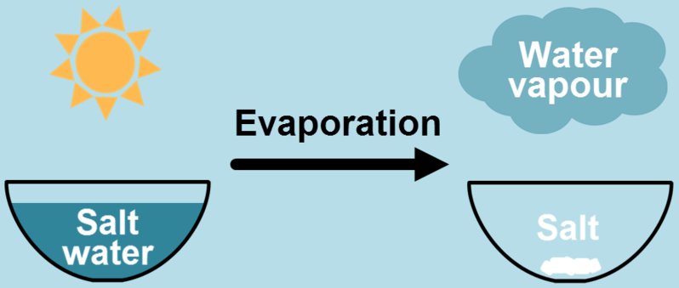
Evaporation and crystallisation probably seem very similar, but they are actually rather different.
Evaporation takes any solution and removes the solvent. This deposits the solute around the container. Small crystals often form.
Crystallisation adds as much solute as possible to saturate the solution, then cools it to form large crystals. There is still a solution left over.

Slide 9

This means we can dissolve a lot of solute into solution at a high temperature, and then slowly cool it.
Fast cooling does not create large crystals, because the solute does not have time to arrange itself into neat crystals.
To make larger crystals, we need to cool the mixture slowly.

